Slide 1
Welcome to .NET Aspire Developers Day!
Glenn Condron & Maddy Montaquila

Slide 2
.NET Aspire – Your building blocks for cloud development

Slide 3
Every App Needs
Observability
Resiliency
Scalability
Manageability

Slide 4
.NET 8 gives you a lot in the box
Observability
Resiliency
Scalability
Manageability
Built in metrics with dimensions
New Polly based resiliency packages
AOT (increased density)
Certificate auto-rotation support in Kestrel
DI integration for metrics
SignalR Stateful Reconnect
Performance
Better Logging support (faster, can object serialization)
Chiseled Ubuntu
Enrichment
Redaction
Testing fakes for Logging & Metrics

Slide 5
But… it’s not that simple

Slide 6
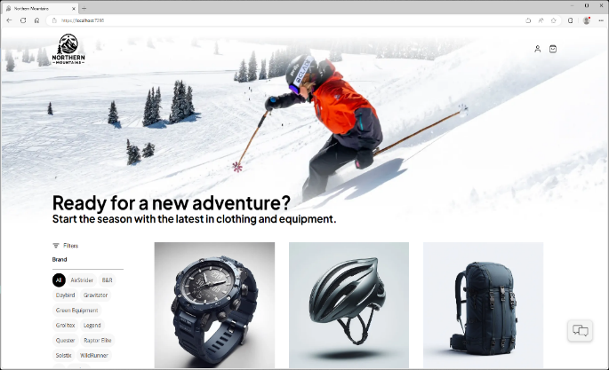
Cloud Services
Web App
Blazor App
Data Source

Slide 7

Cloud Services
Web App
Blazor App
Backend API
PostgreSQL
Identity
Catalog
Order
Basket
Payment

Slide 8



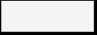


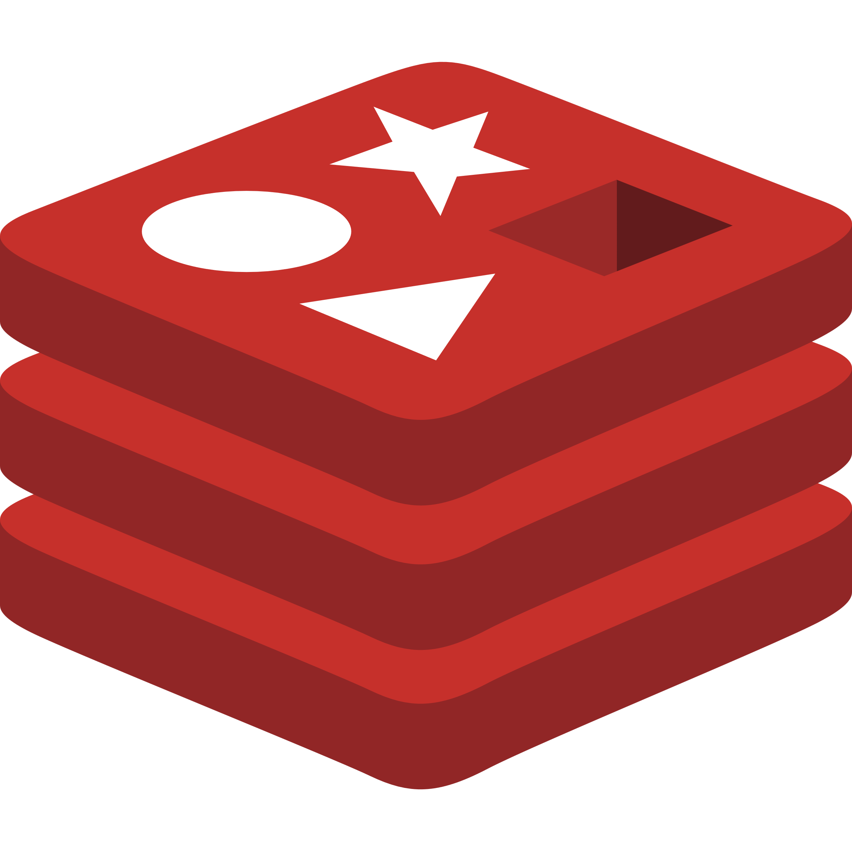


Cloud Services
Client Apps
Identity Service
Mobile BFF
Identity API
PostgreSQL
Mobile App
OpenAI
Mobile API
Catalog Service
Catalog API
PostgreSQL
Order Service
Ordering API
Web App
Ordering API
Order Processor
PostgreSQL
Event Bus
Browser
Blazor App
Basket Service
Basket API
Redis
Payment Service
Payment Processor
Admin Services
Webhook Client
Webhooks Service
Observability
Webhooks API
PostgreSQL

Slide 9














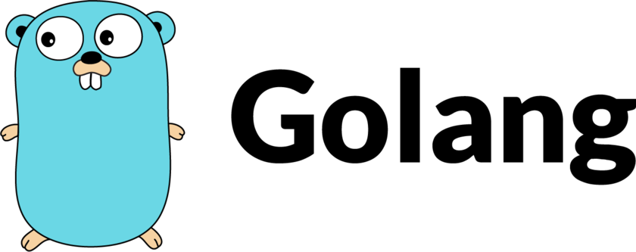
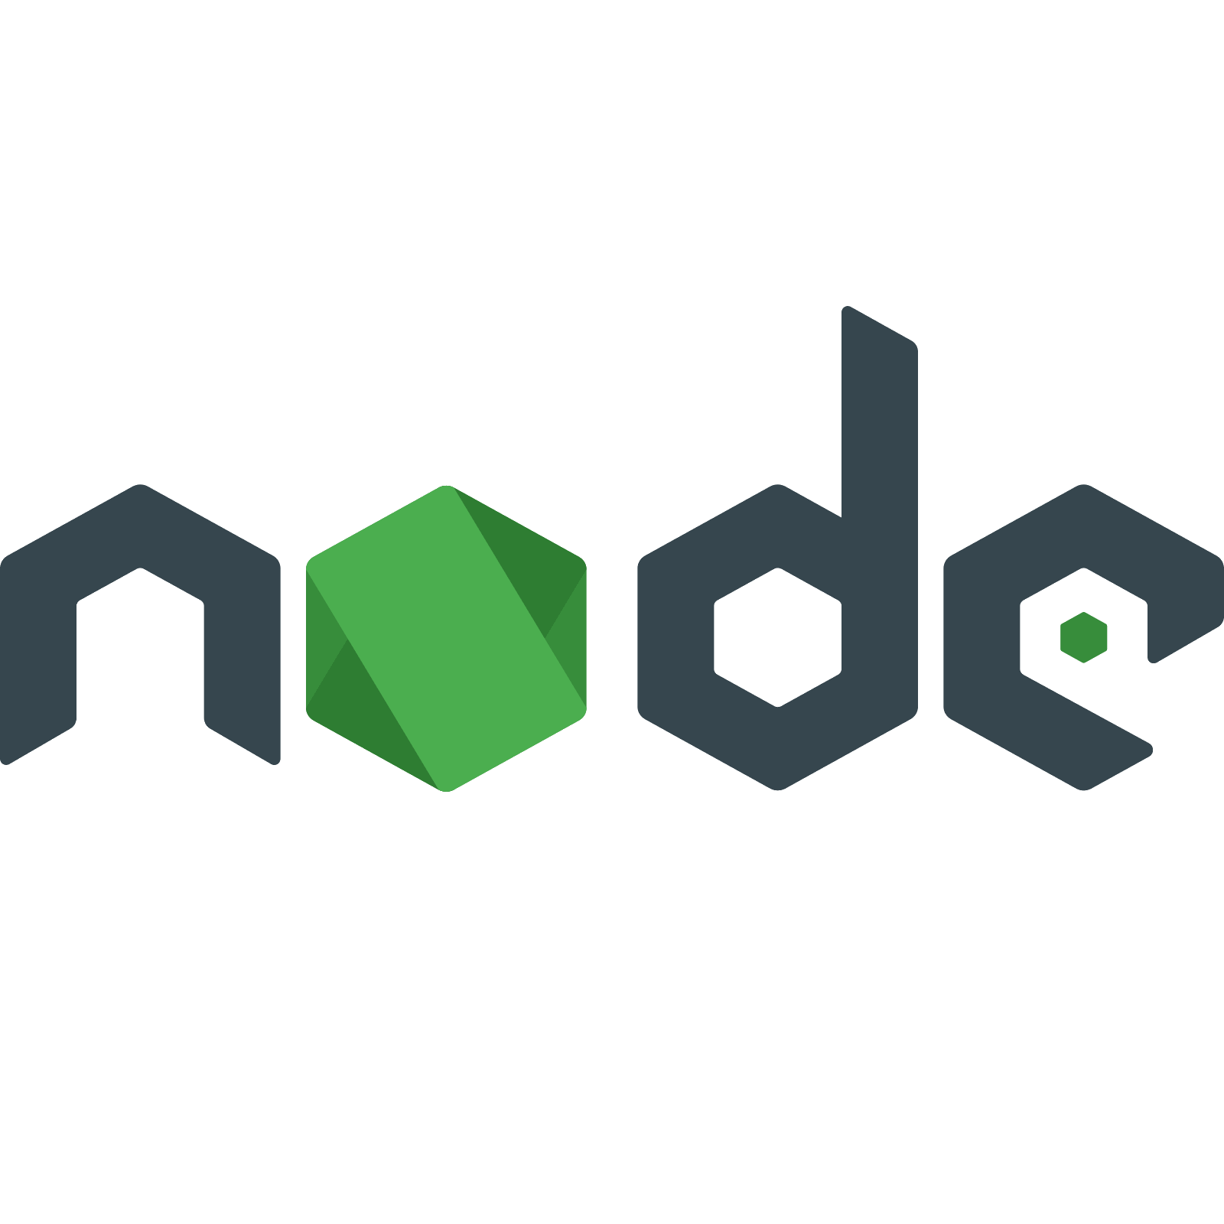


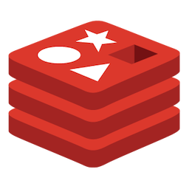
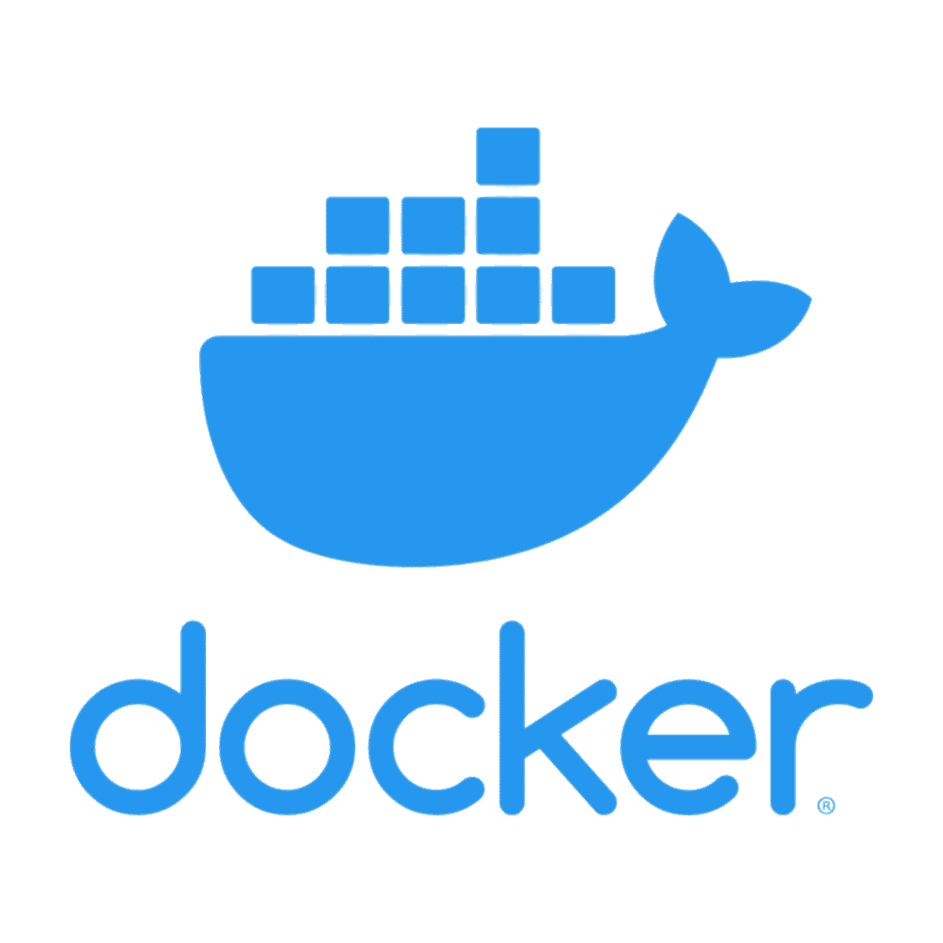






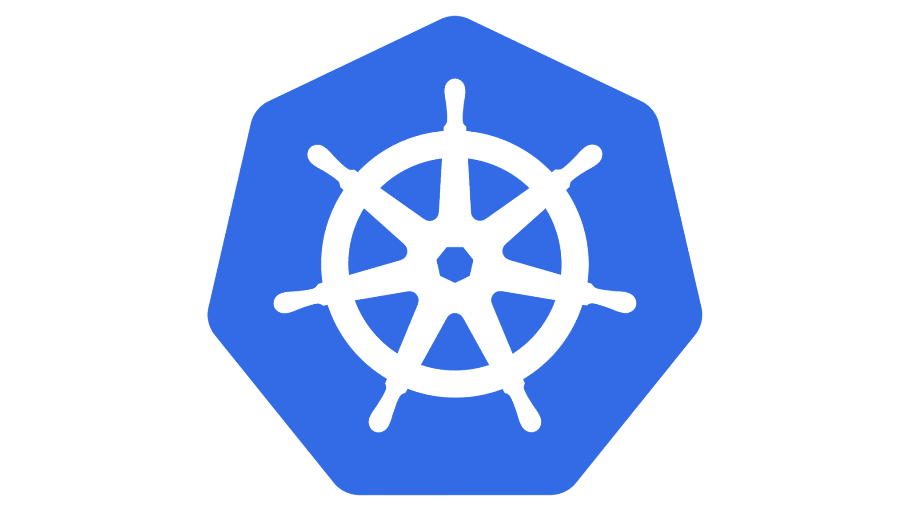
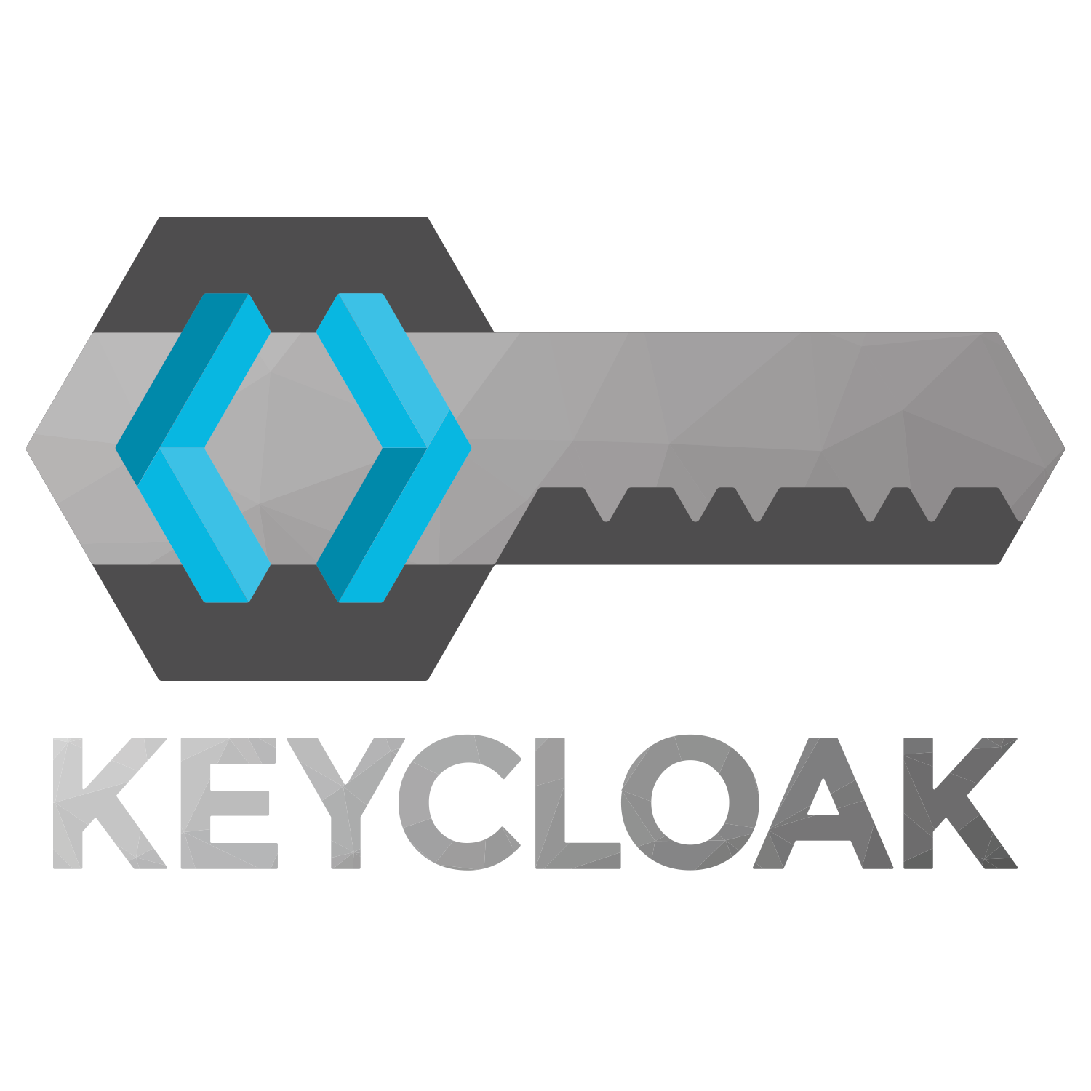


Your average cloud dev deals with:
Caching
Databases
Local development tools
Messaging + queueing
Containers?!
Multiple languages
A zillion deployment targets
Resiliency + scalability
Security + networking
CI/CD
Storage but… not databases?!
Telemetry and logs and traces
Authentication
AI?!?!?!
and so much more!

Slide 10
And then there’s onboarding…
Acquire all the dev tools
IDE/editor
Language SDKs + runtimes
Container system + emulators
Get all the pieces working individually
Or… deploy to a staging environment
Don’t forget to authenticate! Somehow!
Ever heard of mock data? You have now!
Don’t forget the one random specific thing your company requires!
Connect them all? Maybe?
Or just test them individually and hope it works in prod
If you’re lucky someone wrote a script
Write code…
…and hope you’re setting the right things
Learn quirks of the individual services
Do not touch anything or it all breaks instantly

Slide 11
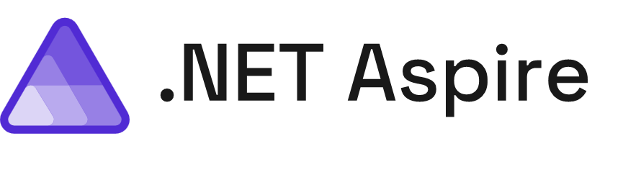
A cloud ready stack for building observable, production ready, distributed applications
Smart Defaults
Developer Dashboard
Orchestration
Service Discovery
Components
Deployment

Slide 12

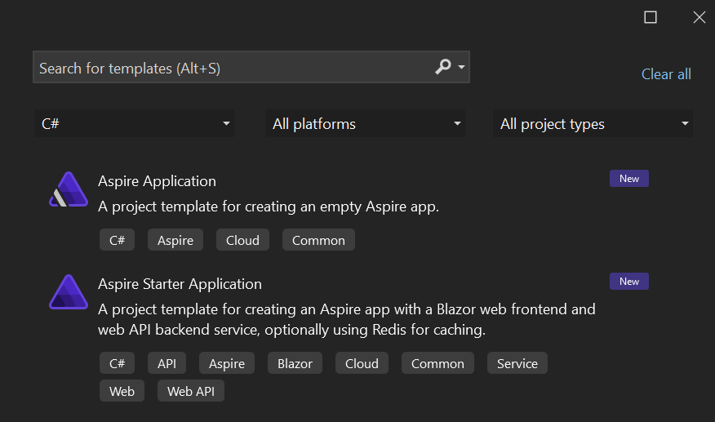
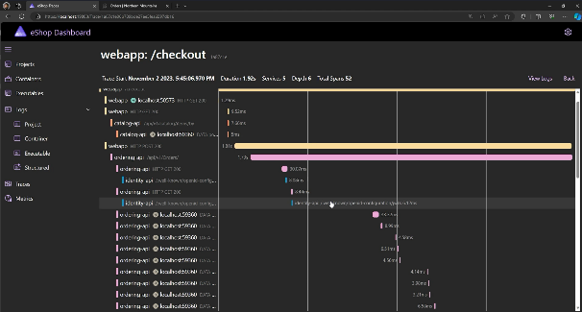
Easy to get started
Easy to build
Easy to deploy
Open-source
Templates
Components
Service discovery
Developer dashboard
Logs, metrics, distributed traces
Single command run
App topology in C#
Cloud deployment

Slide 13
Let’s add .NET Aspire to an app
Websites need the cloud too

Slide 14
What happens when I need to deploy this to the cloud?

Slide 15





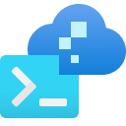





Flexible Deployment with .NET Aspire
How You Do It Today!
AWS CDK
Azure Dev CLI
Visual Studio

Slide 16
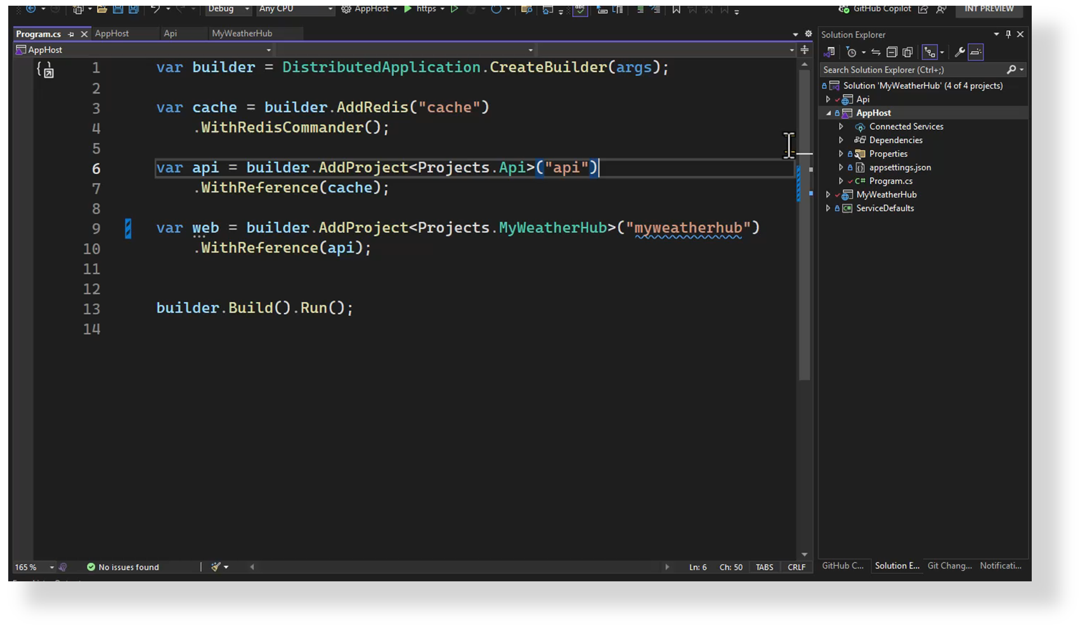

Slide 17
It’s not just .NET
Bring all your friends!

Slide 18
Announcing .NET Aspire 8.1
Use Dockerfiles in your AppHost
Support for Python projects
Improvements to local database login experience
New Aspire components from KeyCloak, Milvus, Garnet, ElasticSearch, and Valkey
Releasing TODAY!
*Thank you to all of our community contributors – including @wmeints and @alirexaa!

Slide 19
.NET Aspire Developers Day
Start your learning journey:
aka.ms/dotnetAspireDevDay/Collection

Slide 20

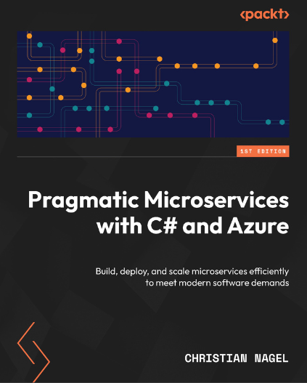
Pragmatic Microservices with C# and Azure Christian Nagel
25% discount
aka.ms/dotnetAspireDevDay/Discount
Valid July 15, 2024 – August 14, 2024

Slide 21

Event Survey
aka.ms/dotnetAspireDevDay/Survey

